Slide 1

Geometry
Unit 10, Lesson 3 Radian Measure Volume 2, pg. 130

Slide 2


Benchmark
MA.912.GR.6.4
Solve mathematical and real-world problems involving the arc length and area of a sector in a given circle.
volume 2, pg. 130

Slide 3
Integrated Mathematical Thinking and Reasoning Standards
MA.K12.MTR.1.1 Actively participate in effortful learning both individually and collectively.
MA.K12.MTR.2.1 Demonstrate understanding by representing problems in multiple ways.
MA.K12.MTR.4.1 Engage in discussions that reflect on the mathematical thinking of self and others.
MA.K12.MTR.5.1 Use patterns and structure to help understand and connect mathematical concepts.
MA.K12.MTR.6.1 Assess the reasonableness of solutions.
volume 2, pg. 130

Slide 4

Learning Targets
I can define radian.
I can explain the relationship between the length of the arc intercepted by an angle to the radius.
volume 2, pg. 130

Slide 5

Warm-Up
volume 2, pg. 130

Slide 6
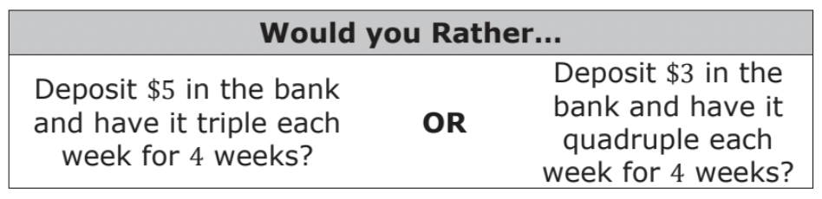
10.3.1 Warm-Up: Would You Rather?
Which would you rather choose? Justify your reasoning using mathematics.
volume 2, pg. 130

Slide 7

Exploration
volume 2, pg. 131

Slide 8

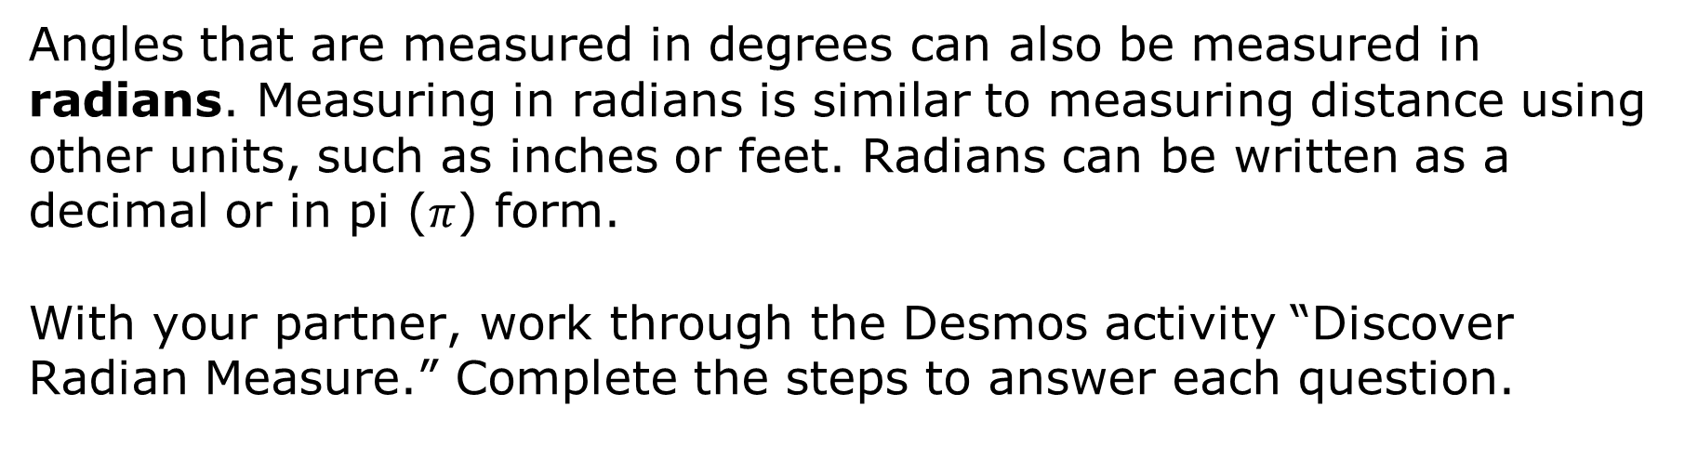
10.3.2 Exploration: Discovering Radian Measure
volume 2, pg. 131

Slide 9
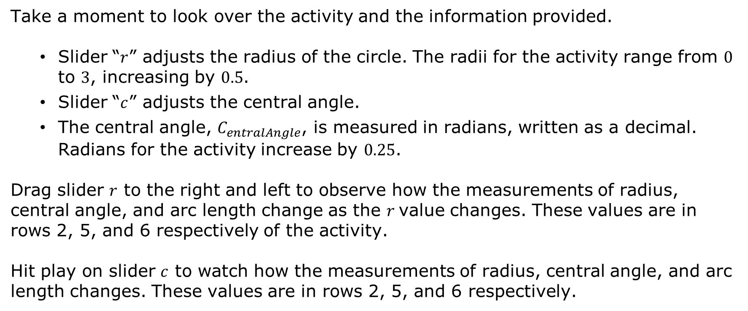
volume 2, pg. 131

Slide 10
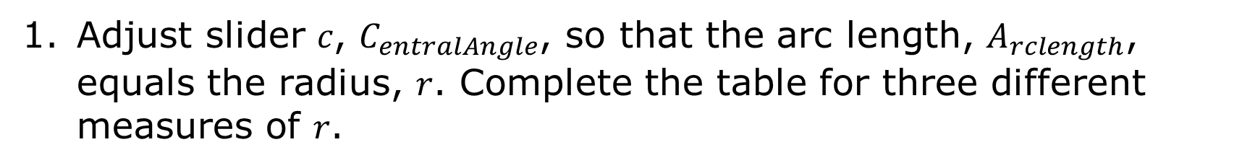
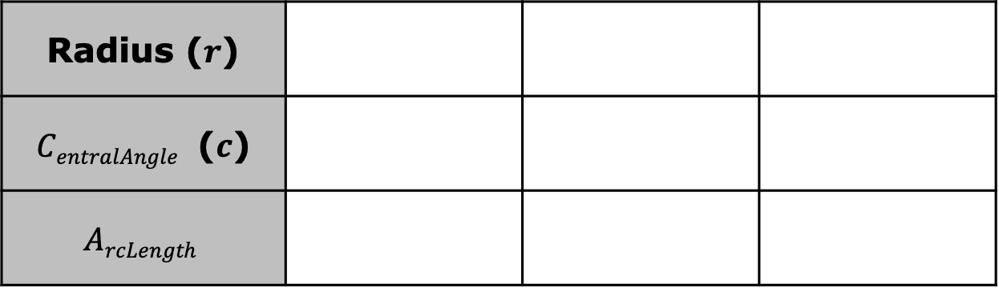
Radius ($r$)
$CentralAngle$ ($c$)
$$ArcLength$$
Describe the relationship observed in the table between the measure of the arc length and the measure of the radius.
volume 2, pg. 131

Slide 11
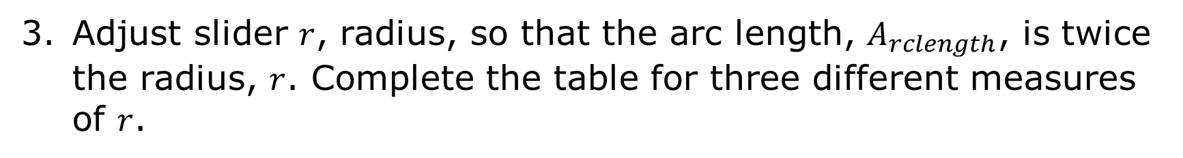

Radius ($r$)
$CentralAngle$ ($c$)
$$ArcLength$$
Describe the relationship observed in the table between the measure of the arc length and the measure of the radius.
volume 2, pg. 131

Slide 12
Complete the statements based on your work in questions 1-4.
A radian is a unit used to express the measure of an angle. Radians are based on the number of of a circle being wrapped along the of the circle.
The radian measure of a central angle is equal to the length of the intercepted by the central angle divided by the
angles
radii
diameter
circumference
arc
radius
radius.
arc length.
volume 2, pg. 132

Slide 13
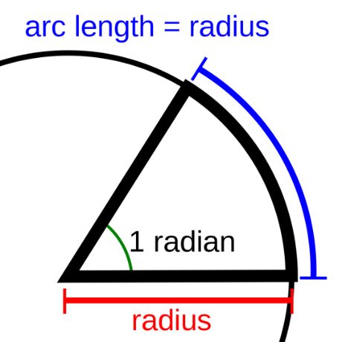
Describe how the diagram shows the relationship between the radius and arc length.
volume 2, pg. 132

Slide 14
Exploration
volume 2, pg. 132

Slide 15
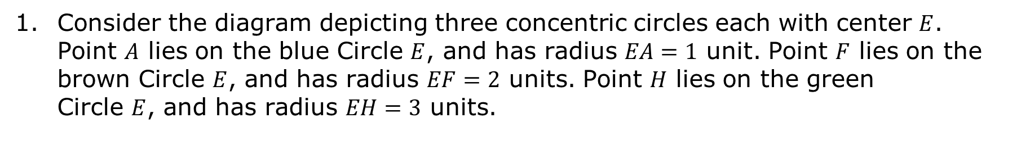
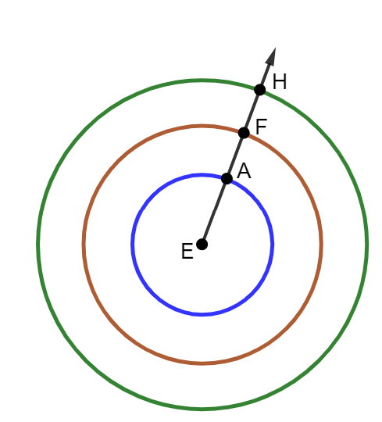
10.3.3 Exploration: Discovering Radians in a Whole Circle
volume 2, pg. 132

Slide 16
Complete the table with your partner.
Circle | Circumference | Ratio of Circumference to Radius
Radius $$EA=1 unit$$
Radius $$EF=2 units$$
Radius $EH=3 units$
volume 2, pg. 132

Slide 17
Discuss any observations you made about the values in the table with your partner. Summarize your discussion.
c. Write a conjecture about the ratio of the circumference to radius and a whole circle measured in radians.
volume 2, pg. 133

Slide 18

Bring It Together
volume 2, pg. 133

Slide 19

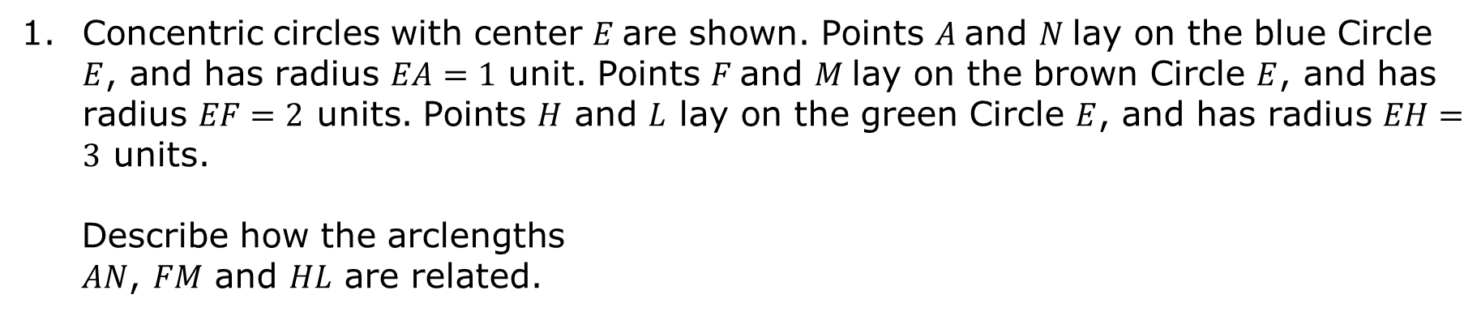
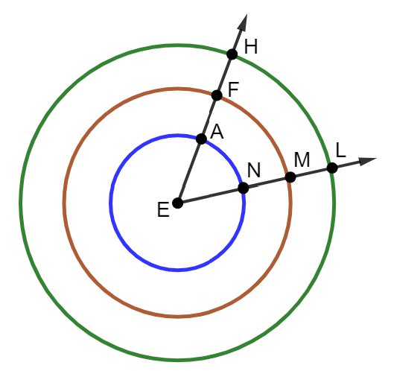
10.3.4 Bring It Together: Relating Arc Length to the Radius
volume 2, pg. 133

Slide 20
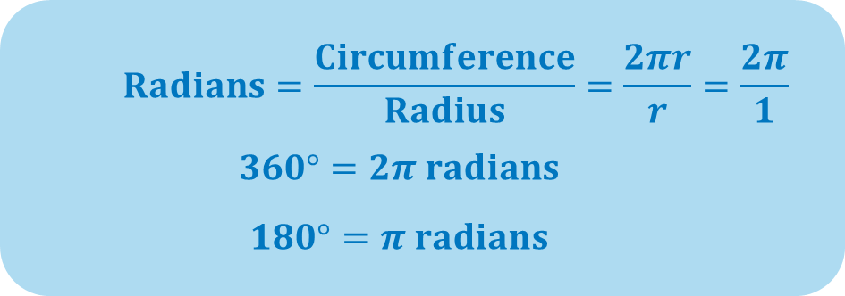

Use words from the bank below to complete the statements.
angle arc radian radius
The length of the ____________ intercepted by a(n) ____________ is proportional to the ____________ of the circle. The ____________ measure of the angle is the constant of proportionality.
volume 2, pg. 134

Slide 21

Wrap-Up
volume 2, pg. 134

Slide 22
10.3.5 Wrap-Up: Cool Down
Your friend was absent today and will need notes from class. Write a quick note to help them understand relationship between the length of an arc intercepted by an angle and the radius.
volume 2, pg. 134

